Slide 1
Sample Netflix charts and use cases
Matt Kaufmann
January 2022

Slide 2
I have created two scripts that are able to be used from the command line
1: Cleaning Netflix viewing data
2: Creating graphs from said viewing data

Slide 3
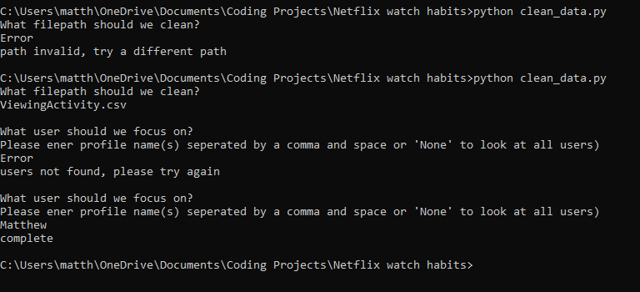
Cleaning Netflix viewing data example script

Slide 4
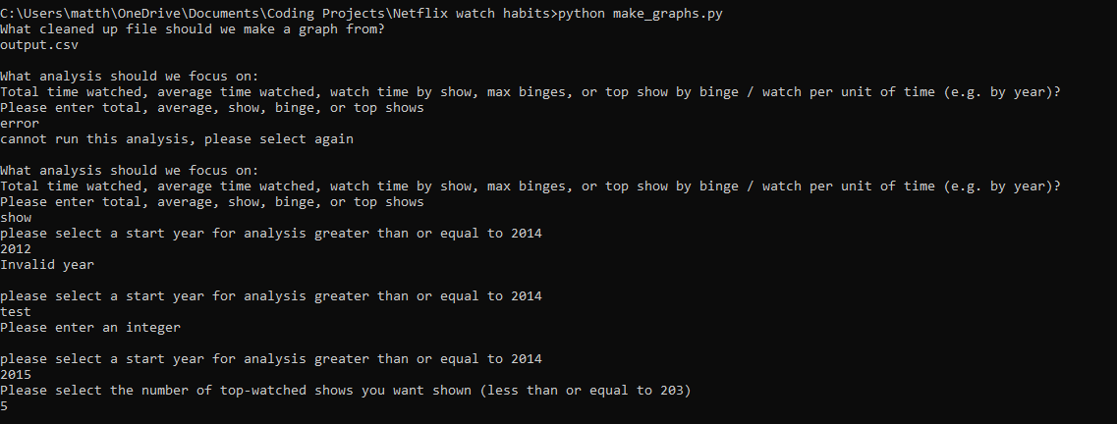
Analyzing Netflix viewing data example script…

Slide 5
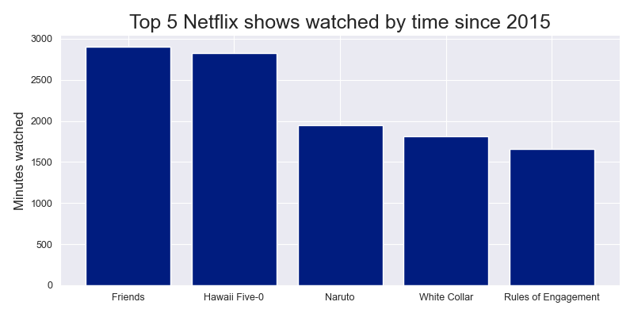
…And resulting output

Slide 6
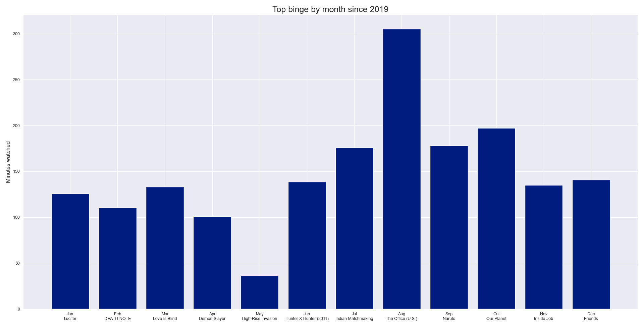
Can be utilized for additional outputs

Slide 7
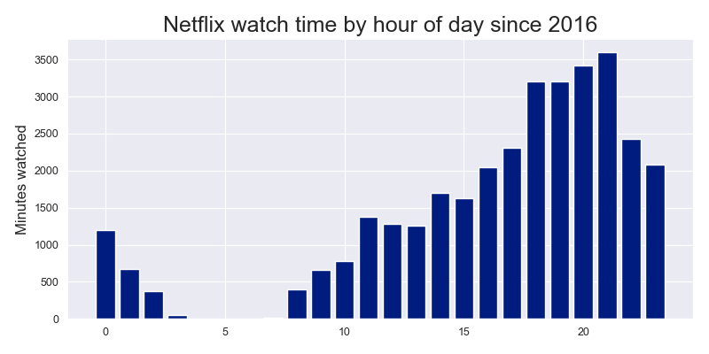
Can be utilized for additional outputs (cont’d)

Slide 8
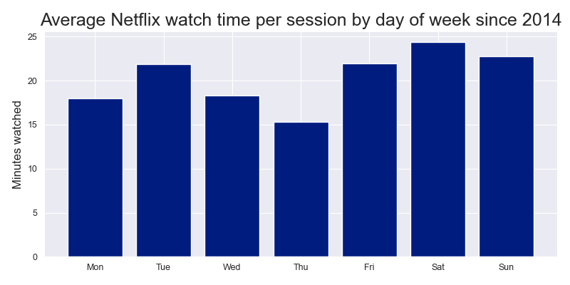
Can be utilized for additional outputs (cont’d)

Slide 9
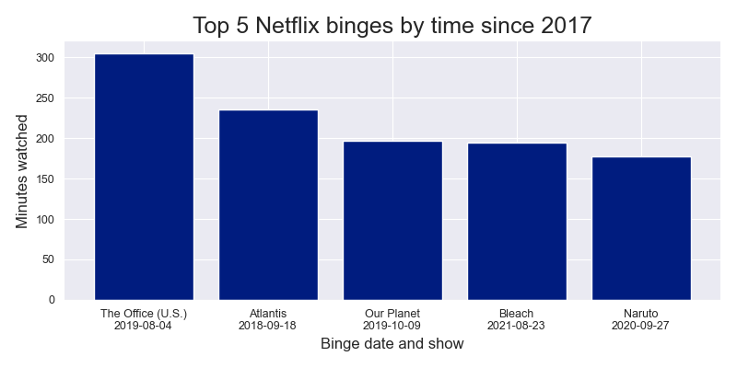
Can be utilized for additional outputs (cont’d)

